Slide 1

Prepared by SHAHD EYAD ETHALATHINI
Expert System Project
Post-war building assessments system
2025

Slide 2
Introduction
My project focuses on developing an intelligent expert system to evaluate building damage and prioritize repair actions based on multiple factors. By integrating fuzzy logic principles, this system analyzes structural damage, neglect levels, material degradation, hazard exposure, and other related parameters. Helping decision-makers allocate resources efficiently and reduce the risk of further damage

Slide 3
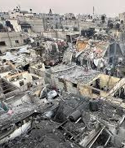
Project Steps
1-Make list challenges
2-Build the Knowledge Base
3-Make code in Fuzzy Logic
4-Test code with 3 test cases demonstrating both forward chaining and backward chaining.

Slide 4
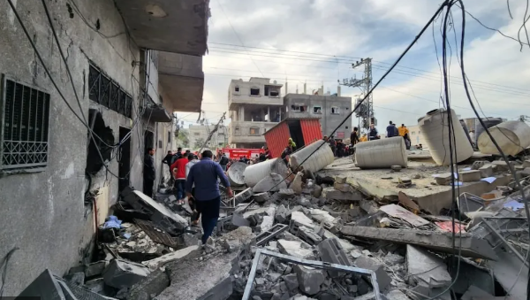
Methodology
Problem Definition and Objective Setting:
Data Collection and Input Design:
Fuzzy Logic System Design:
Control System Implementation:
Testing:

Slide 5
1-Make list challenges
Lack of accurate data Original documents for buildings, such as engineering models, may be missing or inaccurate due to war
Hidden or invisible damage, such as erosion of the foundations or internal structure of the building as a result of bombing or explosions.
If the building is left without maintenance for a long period after the war, neglect can lead to increased structural damage.
The presence of hazardous or radioactive materials may hinder the assessment and further complicate the restoration process.
Determine the budget for reconstruction.
Examine whether restructuring will be more expensive or more effective than rebuilding the building from scratch.
Determine the extent of the war’s impact on the surrounding area, such as contamination or destruction of local infrastructure (roads, public networks).
Examine the integrity of the building’s basic structure (foundations, columns, roofs).
Evaluate cracks in walls and curved surfaces (these cracks may be an indication of structural weakness).

Slide 6
2-Build the Knowledge Base
IF hidden damage is suspected due to erosion, internal issues, or war impacts
THEN
Prioritize high-risk areas like foundations, load-bearing walls, and critical joints for inspection
IF prolonged neglect of a building is evident
THEN
Perform rapid assessments to identify critical failures
IF cracks, deformities, or foundational instability are observed
THEN
Recommend temporary shoring or bracing if the structure poses a collapse risk

Slide 7
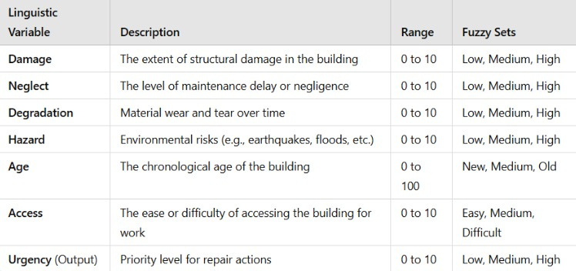

Slide 8
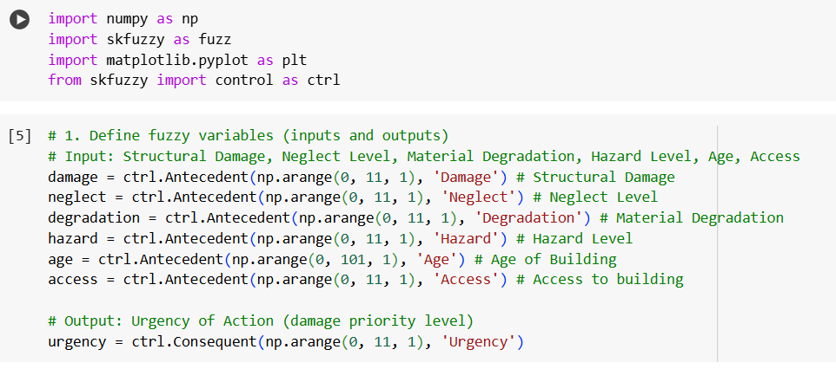
3-Make code in Fuzzy Logic

Slide 9
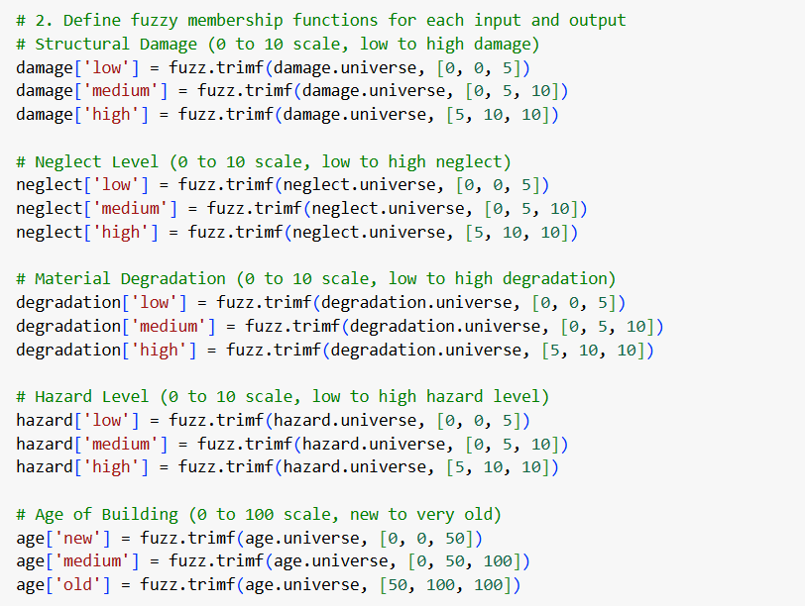
3-Make code in Fuzzy Logic

Slide 10
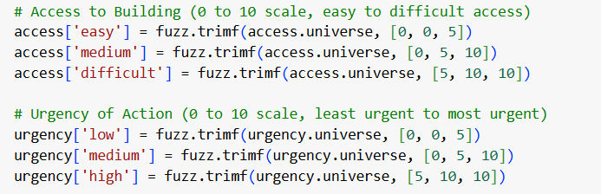
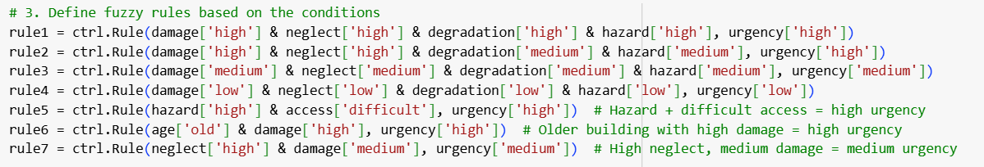
3-Make code in Fuzzy Logic

Slide 11

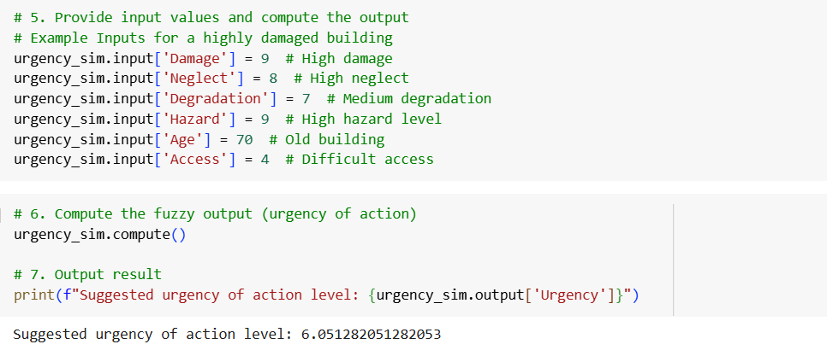
3-Make code in Fuzzy Logic

Slide 12
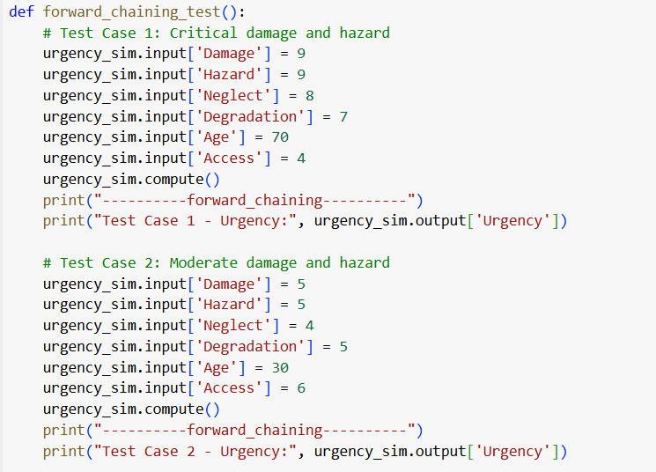
Test Case BY Fowrowerd chaining

Slide 13
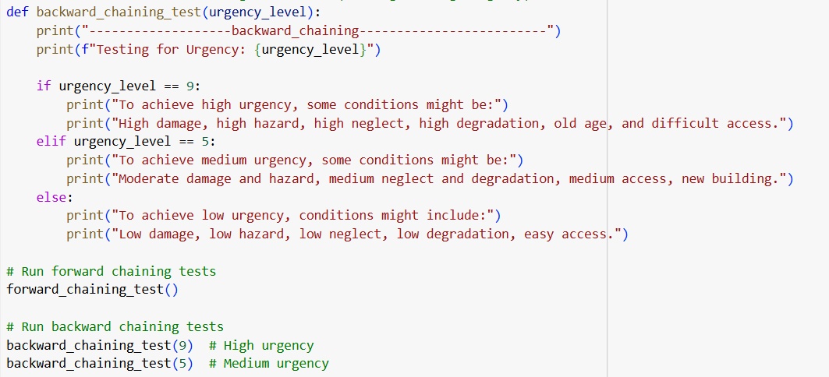
Test Case BY Backword chaining

Slide 14
Conclusion
The expert system developed in this project successfully addresses the critical need for evaluating and prioritizing building damage based on urgency. By leveraging fuzzy logic, we created a dynamic decision-making framework capable of handling the inherent uncertainties in assessing structural damage, neglect levels, material degradation, hazard risks, building age, and accessibility. The system offers a practical tool for stakeholders to allocate resources effectively and take timely action to mitigate risks
The results demonstrate the system's robustness and adaptability across various scenarios as validated by case studies. These cases highlight how input parameters dynamically influence the output ensuring accurate prioritization of actions based on real world conditions

Slide 15
Thank you

